Slide 1



AcF 304 Financial Markets – Week 16 Commercial Awareness
Session Code:
654848
Notes:
If this PowerPoint presentation contains mathematical equations, you may need to check that your computer has the following installed:
1) MathType Plugin
2) Math Player (free versions available)
3) NVDA Reader (free versions available)

Slide 2
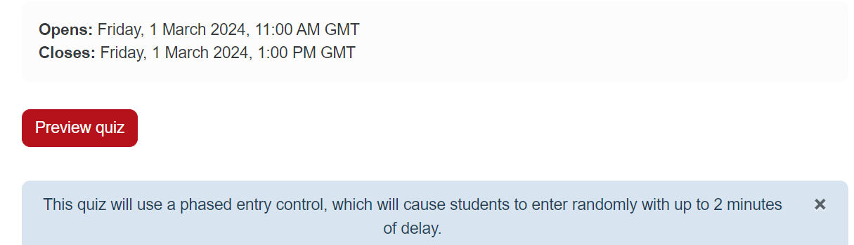
AcF 304 End Term Test
WEEK 17 - As per your timetable - test will be on module Moodle page
.
You must start the test before 12.00 in order to complete.
Test is inclusive of Week 17 work.

Slide 3

AcF 304 End Term Test 2 50 ONLINE Multiple Choice Questions in 60 minutes Random questions for each student from a large bank of questions
If you have any technical difficulties – in order for the university to try and assist you…
Email:
- during the exam – NOT 30 minutes afterwards
- provide photo evidence of any problems with your email
Good luck!

Slide 4
Key themes – Session 2
Non-Farm Payroll economic data release and affect on financial markets
Debt/GDP ratios - focus on Japan
GameStop +8000%
..including Payment For Order Flow
Session Code:
654848

Slide 5

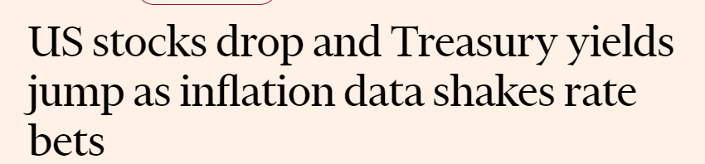
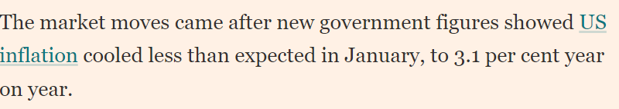
Last Week…(data not assessable)
Session Code:
937691

Slide 6
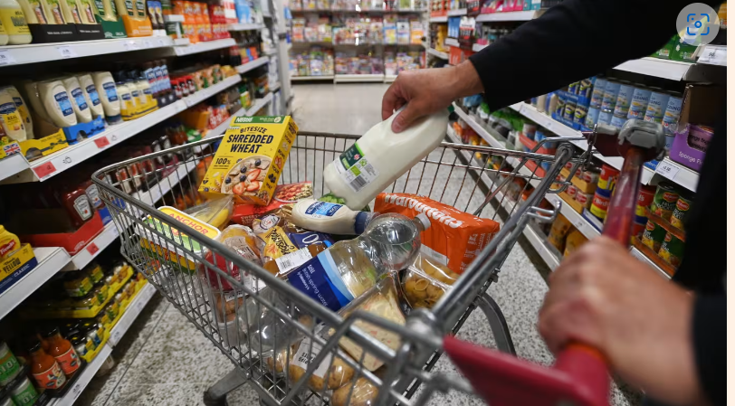
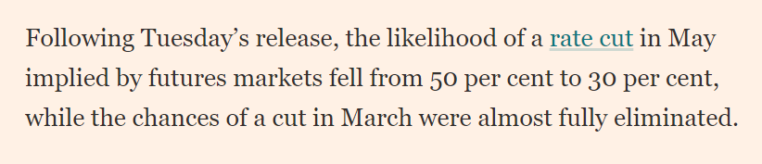
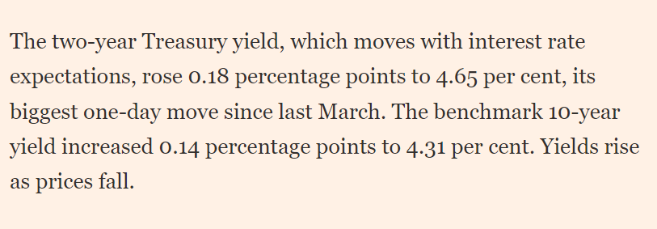
Last Week…(data not assessable)

Slide 7
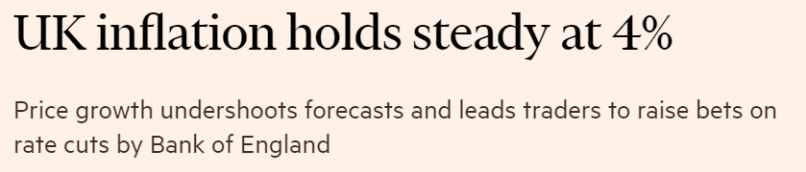
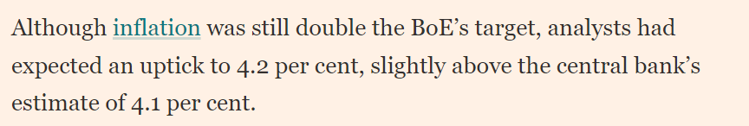
Last Week…(not assessable)
Session Code:
937691

Slide 8
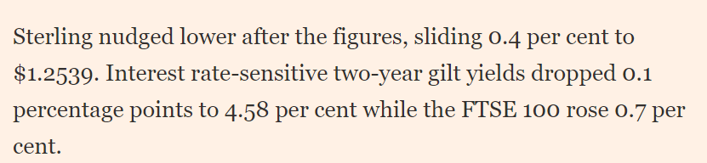
Last Week…(data not assessable)

Slide 9
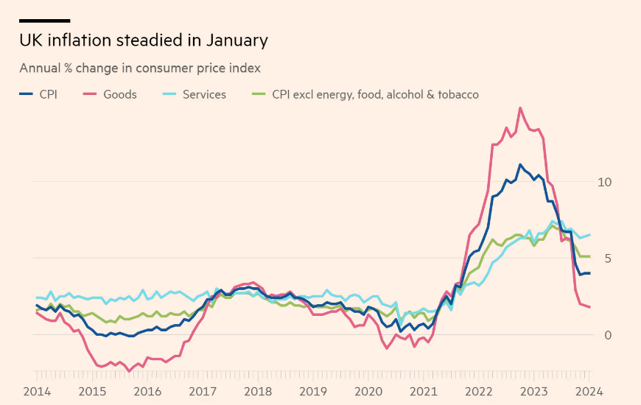
Last Week…(data not assessable)

Slide 10
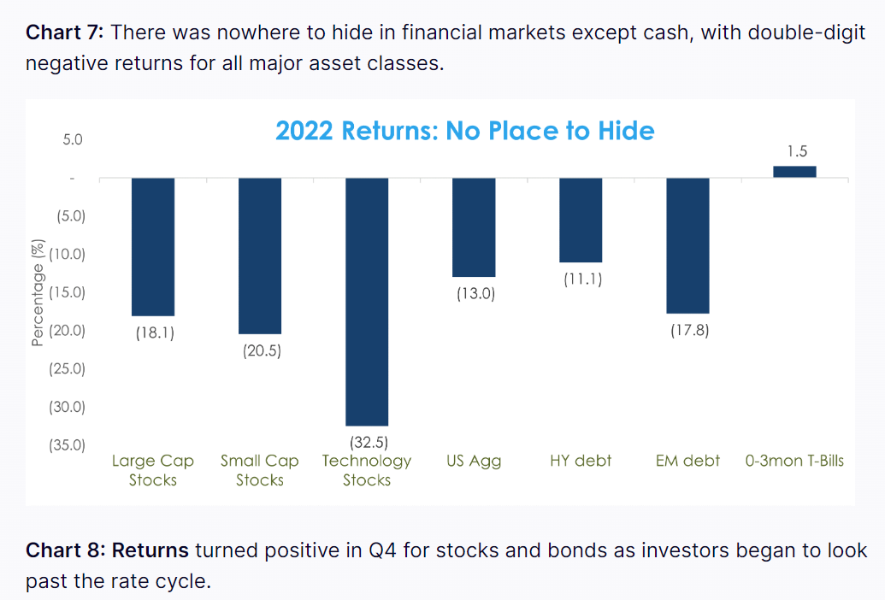
2022 - Everything was down !!!

Slide 11
2022 – Everything was down!!!
Classic portfolio theory was broken in 2022!

Slide 12
Classic portfolio theory was broken in 2022!
Traditionally = 60% stocks / 40% bonds

Slide 13
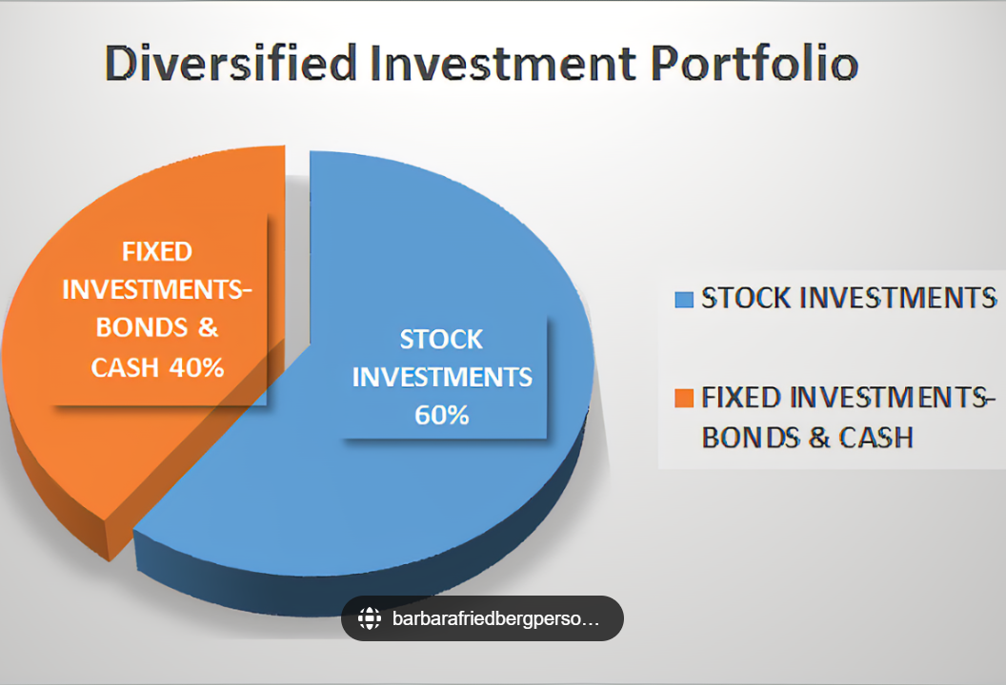
Classic Portfolio Theory

Slide 14
Classic Portfolio Theory
Traditionally = 60 per cent stocks / 40% bonds
If economy is strong – stocks will do well – but bonds not so well interest rates / inflation goes up = balanced result
If economy is weak /recession – stocks will do badly – but bonds will do well as inflation /interest rates go down = balanced result

Slide 15
Classic portfolio theory was broken in 2022!
Traditionally = 60 per cent stocks / 40% bonds
In 2022 = Minus 17%!!!
$10 trillion was lost!

Slide 16
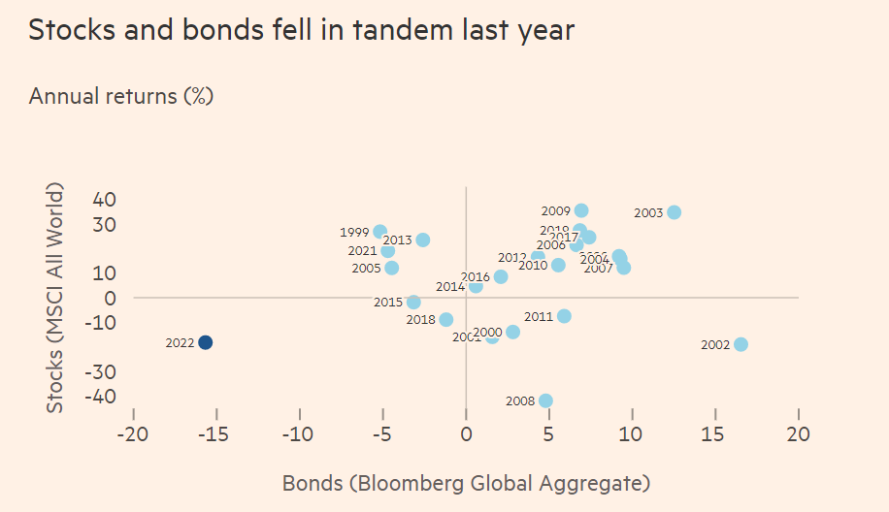

Slide 17

Classic portfolio theory was broken in 2022!
Does classic portfolio theory work anymore!!!
Traditionally = 60% / 40% bonds
Roughly $100 Trillion is invested this way and it has been the strategy for last 70 years

Slide 18
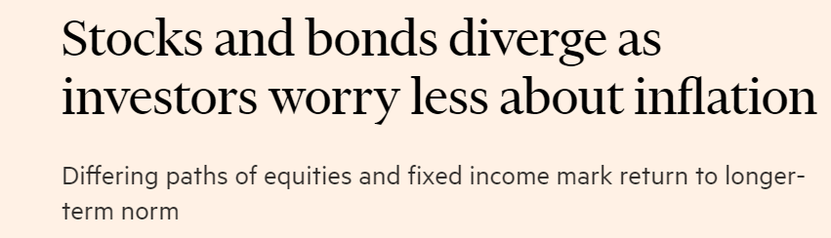
Classic portfolio theory

Slide 19
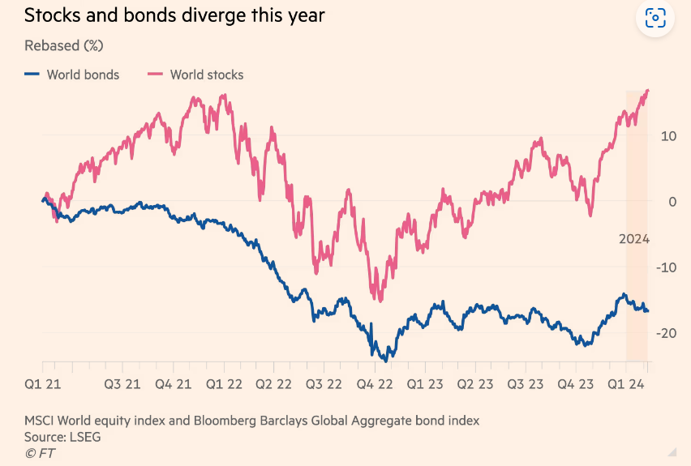
Classic portfolio theory

Slide 20
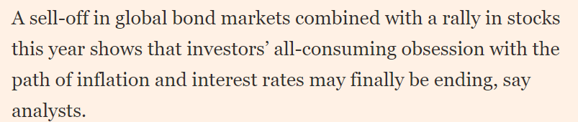
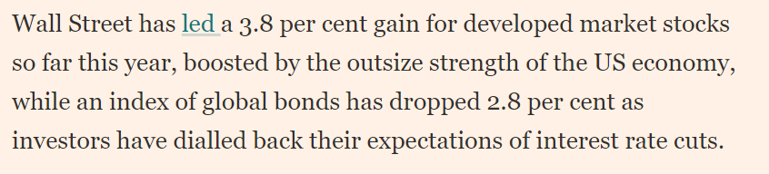
Classic portfolio theory

Slide 21
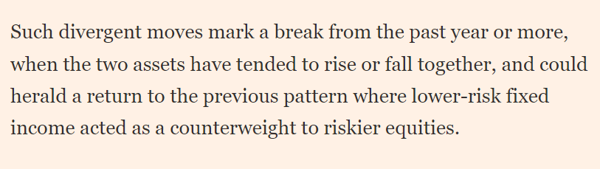
Classic portfolio theory

Slide 22
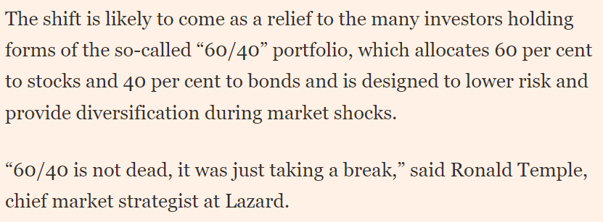
Classic portfolio theory
Stocks and bonds diverge as investors worry less about inflation (ft.com)

Slide 23
Appendix 1
Fixed Income
Corporate Bond Liquidity Problem
Paul McCormick

Slide 24
Structure of FI Market
Market Participants
FI Asset Classes
Demands of Buy Side
Electronic Trading Platforms
Challenges in the market
The FI Market’s response

Slide 25
Market Participants - Buy Side
Institutional Asset Managers: e.g. Blackrock ,PIMCO, Fidelity.
Hedge Funds: e.g.Brevan Howard, BlueCrest Capital Management.
Wealth Managers e.g.UBS WM ,CS WM
Smaller EMEA Banks e.g. ICICI Bank ,BHF

Slide 26
Market Participants - Sell Side
Tier 1 Investment Banks: e.g. Morgan Stanley, Deutsche Bank.
Tier 2 / 3 Banks: e.g. Rabobank, Lloyds Bank.
Sell-side Brokers e.g BGC, ICAP,Tullett Prebon

Slide 27
Fixed Income Asset Classes -1
Government Bonds: US Treasuries, UK Gilts, German Bunds
Sovereigns: e.g. issued by Sweden, Italy to international clients outside the borrowers own country.
Supranationals: e.g. World Bank, European Investment Bank
Covered Bonds e.g.Danish Mortgage Bonds.

Slide 28
Fixed Income Asset Classes -2
Agency Bonds: e.g. issued by semi-government agencies often from the US e.g. Federal Home Loan Mortgage Corporation (Freddie Mac), the Federal National Mortgage Association(Fannie Mae)
Corporates: e.g. IBM, Toyota, Marks & Spencer.

Slide 29
Fixed Income Asset Classes - 3
Emerging Market Bonds e.g. Argentina
MBS/ABS: Mortgage and Asset Backed Securities; defined ‘Derivatives’ and played a huge role in the financial market collapse in 2008 due to the very leveraged nature of these instruments.

Slide 30
FI Asset Class Summary
Governments
Sovereigns
Supranationals
Covereds
Agencies
Corporates
Emerging Market Bonds
MBS/ABS

Slide 31
FI Asset Classes are either classified as Rates or Credit. Separate businesses, P/L and personnel
Governments - Rates
Sovereigns - Rates
Supranationals - Rates
Covereds - Rates
Agencies - Rates
Corporates - Credit
Emerging Market Bonds
Not assessible

Slide 32
Demands of the Buy Side
Institutional Asset Managers: - mainly Governments for liquidity/ease of trading but some Corporate Bonds also (Corps much less liquid)
Hedge Funds: - totally Governments for liquidity reasons
Wealth Managers - Corporate Bonds for higher yield / return
Smaller EMEA Banks –trade all asset classes

Slide 33
Main FI Electronic Trading Platforms -Strengths
Tradeweb: Rates
Bloomberg: All
MarketAxess: Corporates (Institutional)

Slide 34
Demands of the Buy Side
Institutional Asset Managers: - mainly Governments - execute via Tradeweb
Hedge Funds: - definitely Governments - execute via telephone (no trading platform can handle the big sizes)
Wealth Managers - mainly Credit (some EM) - execute via BBG
Smaller EMEA Banks - all - execute via BBG

Slide 35
Current Challenges Of The Market
LIQUIDITY ...
i.e. the current extreme difficulty of executing trades in any reasonable size in the Corporate Bond Market – the Buy Side cannot transact !!!
.....so accurate price information knowing where the market really is ..is so valuable.

Slide 36
Current Challenges Of The Market Why is This ? What’s changed ? – Fact 1
FX – only 30 major currency pairs e.g.USD/EUR
Equities – only 3000 major stocks in the world. Constituents of FTSE 100, S&P 500, Nikkei, DAX etc..
FI – there are over 400,000 unique bonds !

Slide 37
Current Challenges Of The Market Why is This ? What’s changed ? – Fact 1
E.G. Toyota Motor Corp
Shares trade Japan, Singapore, US ... 8 different SEs only.. i.e. 8 locations = 8 securities to concentrate liquidity in.
Toyota has 731 different bond issues !

Slide 38
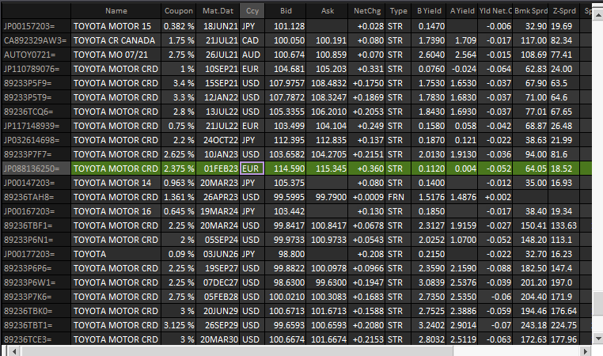
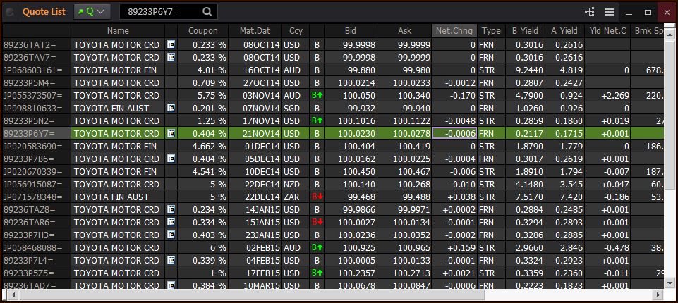
Current Challenges Of The Market Toyota Motor Corp 731 Different Bond Issues

Slide 39
Current Challenges Of The Market Why is This ? What’s changed ? – Fact 1 –So What?
It means trying to find a buyer and a seller of the same bond at the same time in roughly the same size is very difficult.
(Note: a Corporate Bond problem not a Government Bond problem SO 80% of Government Bond trading is electronic versus 30% of Corporates)
Other instruments that are NOT easy to trade electronically include Derivatives & Alternative Investments like Student Housing

Slide 40
Current Challenges Of The Market This wasn’t a problem before 2008 ..
20 MM Toyota 5% 2030
PIMCO
DeutscheBank
Price Returned

Slide 41
Factors influencing a bank’s ability to hold a bond trading position.
Investment Bank Balance Sheets
Capital Requirements

Slide 42
Current Challenges Of The Market This wasn’t a problem before 2008 ..
Investment Bank has a risk position(long/short) in a bond it must set aside a certain amount of capital to cover that risk from a regulatory perspective.
Deutsche buys 10 MM Corporate Bond from client, it needs to set a 4% of capital against it.

Slide 43
Current Challenges Of The Market This wasn’t a problem before 2008 ..
Pre 2008 Deutsche Bank Corporate Bond Global Balance Sheet 4 Billion USD.
Pre 2008 the Capital Requirement of any Corporate Bond was approx 4% i.e. for bank to own 10MM required USD 400,000 (that is 400,000 of 4 Billion).
Post 2008 Deutsche Bank Corporate Bond Global Balance Sheet 1 Billion USD i.e. 25%
Post 2008 the Capital Requirement of any Corporate Bond is approx 8% i.e. for bank to own 10MM requires USD 800,000 (that is 800,000 of 1 Billion).

Slide 44
Current Challenges Of The Market Why is This ? What’s changed ? – Fact 2?
With Balance Sheets down and Capital Requirements up it means Investment Banks cannot hold bonds on their trading book anymore – they haven’t got the capital !
It is Regulation Basle 3 that has changed the Capital Requirement Ratio

Slide 45
Current Challenges Of The Market This wasn’t a problem before 2008 .. this is a problem now!
20 MM Toyota 5% 2018
PIMCO
DeutscheBank
Price Returned in 1 or 2 MM only! PIMCO can’t trade!

Slide 46
PIMCO are just 1 fund manager with large size Corporate Bond trades to execute.The Buy Side can’t trade with IBs in any size anymore !
20 MM Toyota 5% 2018
PIMCO
Blackrock
Fidelity
Deutsche Bank
Morgan Stanley
JPM
15 GMAC 4% 2014
8 MM Alcatel 3% 2022
12 MM ICI 4% 2019
20 MM Toyota 5% 2018
16 MM Deutsche T. 4% 2030

Slide 47
The standard Dealer (IB) to Client trading model is broken
BUY SIDE
PIMCO
Blackrock
Fidelity
UBSWM
CSWM
SELL SIDE
Deutsche Bank
Morgan Stanley
JPM
Barclays
Citi
Tradeweb
Bloomberg
MarketAxess

Slide 48
The market is moving to an All-to-All model where any market participant can trade with another e.g. Blackrock could trade directly with Fidelity,Citi with JPM ! There has been multitude ( 35 ) of new electronic initiatives being proposed. Less than 8 survived. The current platform models are under threat!
Deutsche Bank
Blackrock
JPM
UBSWM
Citi
ALL TO ALL
PIMCO
Morgan Stanley
Fidelity
Barclays
CSWM
Tradeweb ?
Bloomberg ?
MarketAxess ?

Slide 49
Structure of FI Market : Summary
Market Participants
FI Asset Classes
Demands of Buy Side
Electronic Trading Platforms
Corporate Bond Liquidity Challenges in the market

Slide 50
Q Why is there a Corporate bond Liquidity Problem that didn’t exist before the 2008 financial crisis?
Corporate bonds > More instruments than stocks/FX– e.g. Toyota
Match buyers and Sellers? Banks need to hold on to Corp Inventory > Requires Capital.
Since 2008 banks have less capital & Basle 3 Reg means capital requirement has gone up.
Banks can’t hold endless amount Corp Bonds so limits trading bonds – Dealer 2 Client model is broken
All-to-All the solution?

Slide 51
Appendix 1
Fixed Income
Corporate Bond Liquidity Problem
Paul McCormick

Slide 52
AcF 304 Financial Markets – Week 16 Commercial Awareness
Session Code:
654848
Notes:
If this PowerPoint presentation contains mathematical equations, you may need to check that your computer has the following installed:
1) MathType Plugin
2) Math Player (free versions available)
3) NVDA Reader (free versions available)

